Slide 1



Y11 Apps Chapter 10 Skill Development
If one three dimensional object is an enlargement of another such that the ratio is
$$Lengths in original shape:corresponding lengths in enlargement$$
=
$$1:k$$
Then
$$Surface Area of original :Surface Area of enlargement$$
=
$$1:k^{2}$$
and
$$Volume of original :Volume of enlargement$$
=
$$1:k^{3}$$
The quantity ‘k’ is called the scale factor of the enlargement

Slide 2
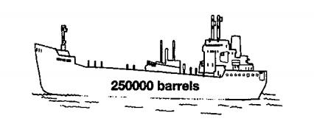
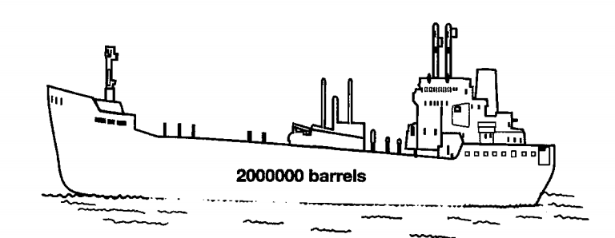
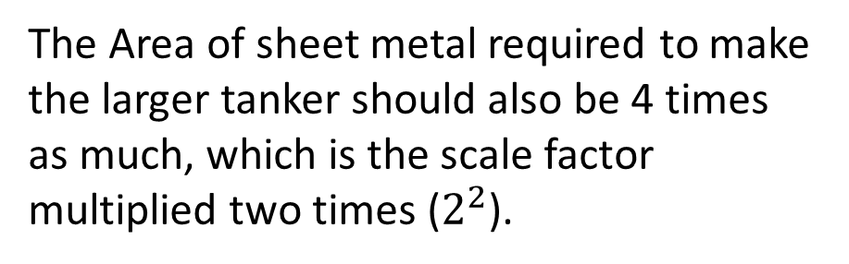
Y11 Apps Chapter 10 Situation 1
Suppose there is an oil tanker that is capable of carrying 250 000 barrels of oil.
If we made another oil tanker with all lengths double that of the original tanker (scale factor of 2), how many barrels of oil could it hold?
Well the volume of the oil tanker should increase by 8 times which is the scale factor multiplied three times ($2^{3}$). Therefore it should be able to hold:
The Area of sheet metal required to make the larger tanker should also be 4 times as much, which is the scale factor multiplied two times ($2^{2}$).

Slide 3
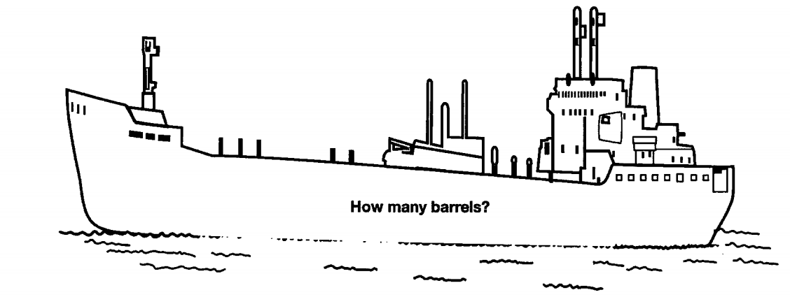


Y11 Apps Chapter 10 Situation 1
If we were to make a tanker three times the original, how many times more barrels could it hold and how many times more sheet metal would be required?
$$Volume= 3^{3}=27 times larger$$
$$SA= 3^{2}=9 times larger$$
Therefore the tanker could hold 27 times as many oil barrels and would require 9 times as much sheet metal to produce!
Now Try Ex 10A

Slide 4
Y11 Apps Chapter 10 Skill Development
If one three dimensional object is a direct enlargement or reduction of another then the two objects are said to be similar
The ratio of any length on one object to that of the corresponding length on the other object will be the same for all pairs of lengths AND
Corresponding angles in the first and second objects will be exactly the same size

Slide 5
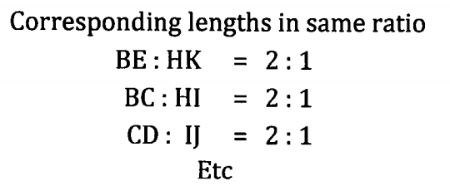
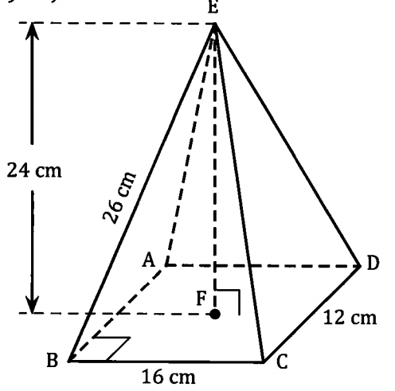
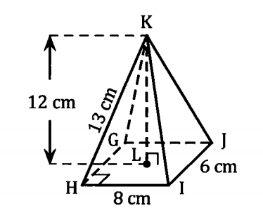
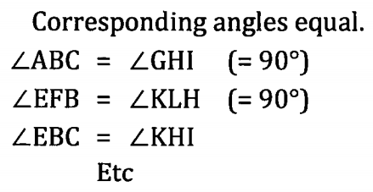
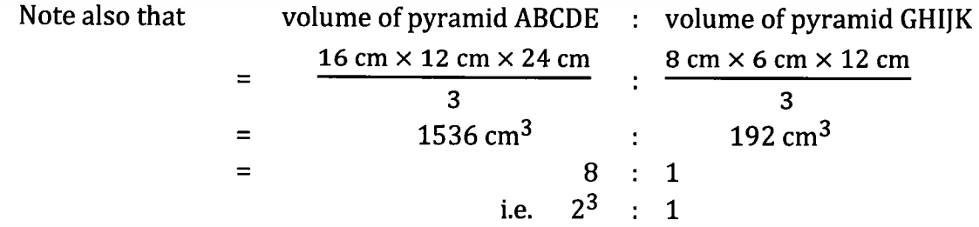
Y11 Apps Chapter 10 Situation
Consider the two shapes below:

Slide 6
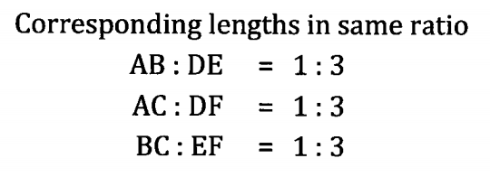
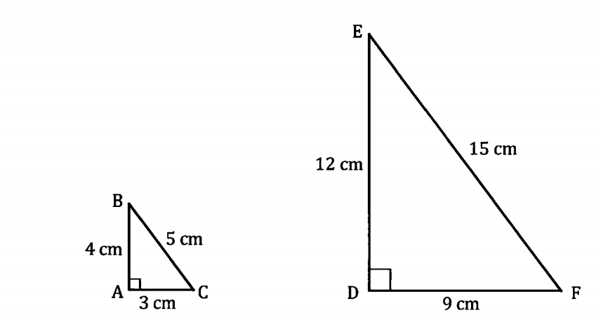
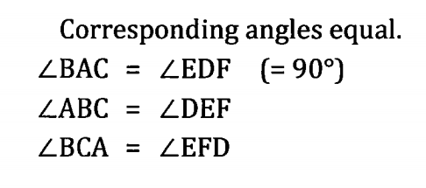
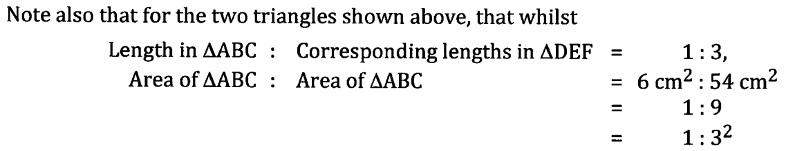
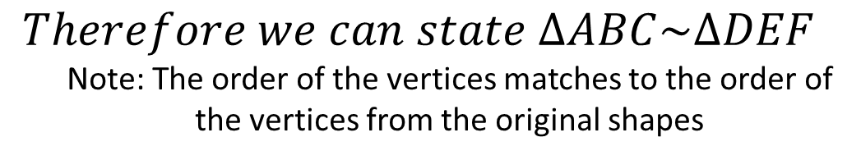
Y11 Apps Chapter 10 Situation 2
Consider the two dimensional shapes below:
$$Therefore we can state ∆ABC\sim ∆DEF$$
Note: The order of the vertices matches to the order of the vertices from the original shapes
Now Try Ex 10B and 10C

Slide 7
Y11 Apps Chapter 10 Skill Development
As you may remember from previous years, there are some simple tests to check if two triangles are similar without knowing all the lengths and angles.
1. Check all angles are equal (AAA)
2. Check all sides are in the same ratio (SSS)
3. Check two sides are in the same ratio and the angle in between them is equal (SAS)
4. In a Right Angles Triangle, check the hypotenuse and another side are in the same ratio (RHS)

Slide 8
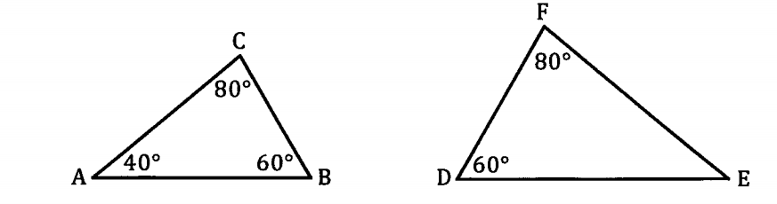
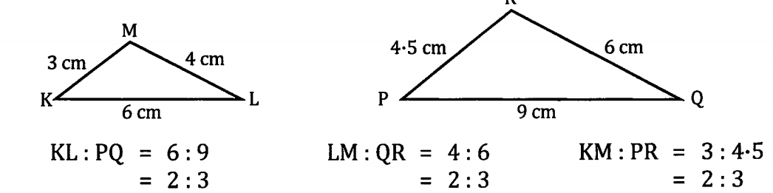
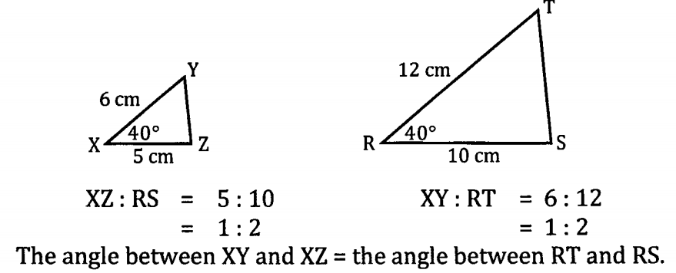
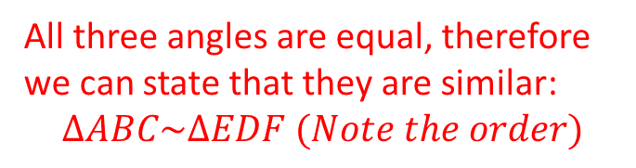
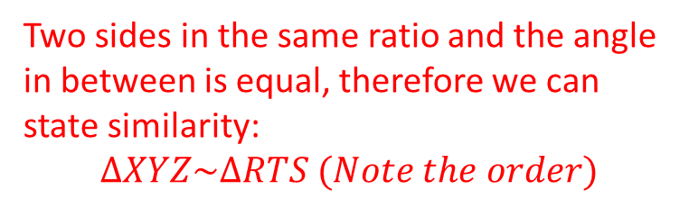
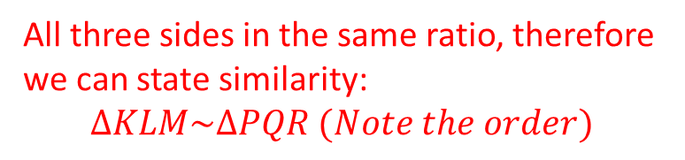
Y11 Apps Chapter 10 Situation
Some examples are listed below:
All three angles are equal, therefore we can state that they are similar:
$$∆ABC\sim ∆EDF (Note the order)$$
All three sides in the same ratio, therefore we can state similarity:
$$∆KLM\sim ∆PQR (Note the order)$$
Two sides in the same ratio and the angle in between is equal, therefore we can state similarity:
$$∆XYZ\sim ∆RTS (Note the order)$$

Slide 9
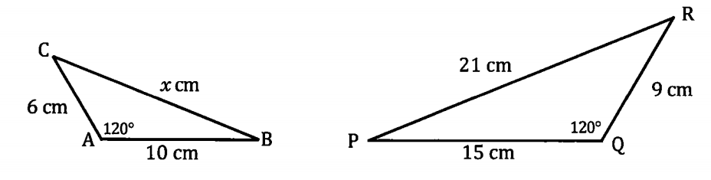
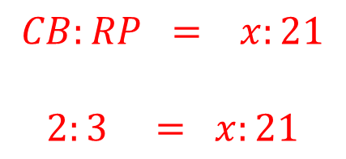

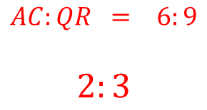
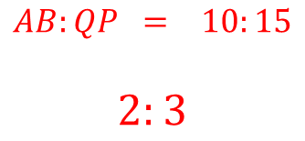

Y11 Apps Chapter 10 Example 1
Explain why the two triangles below are similar and hence find $x$.
$$AB:QP = 10:15$$
$$2:3$$
$$AC:QR = 6:9$$
$$2:3$$
Therefore the sides are in the same ratio and the angles in between are both $120°$
$$∆ABC\sim ∆QPR$$
$$CB:RP = x:21$$
$$2:3 = x:21$$
$$x=14$$

Slide 10
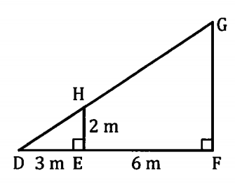
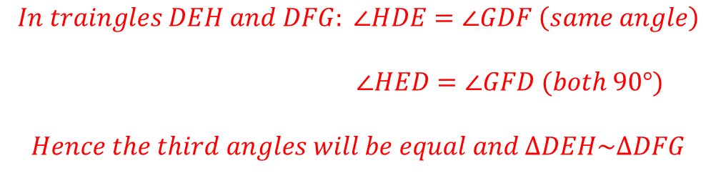
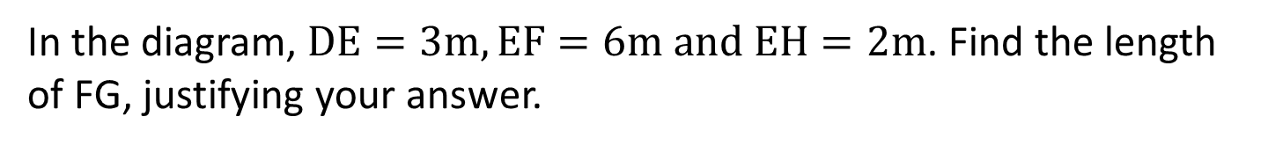
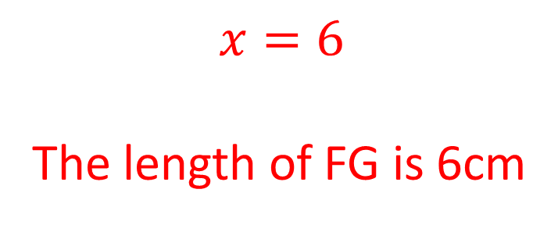
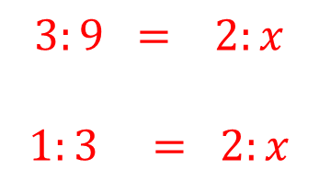
Y11 Apps Chapter 10 Example 2
In the diagram, $DE=3m, EF=6m and EH=2m$. Find the length of FG, justifying your answer.
$$In traingles DEH and DFG: ∠HDE=∠GDF \left(same angle\right)$$
$$∠HED=∠GFD (both 90°)$$
$$Hence the third angles will be equal and ∆DEH\sim ∆DFG$$
Which means all sides are in the same ratio, $DE:DF=EH:FG, the length of FG is x$
$$x=6$$
The length of FG is 6cm
$$3:9 = 2:x$$
$$1:3 = 2:x$$
Now Try Ex 10D

